Slide 1
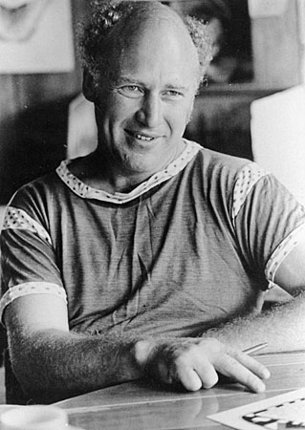
Ken Kesey
Steve Yeh

Slide 2
Early Life
Born Kenneth Elton Kesey in Colorado on September 17, 1935
Went on to study at University of Oregon and enrolled in a creative writing program at Stanford University, where he began the manuscript for One Flew Over the Cuckoo’s Nest
“I was too young to be a beatnik and too old to be a hippie”-Kesey

Slide 3
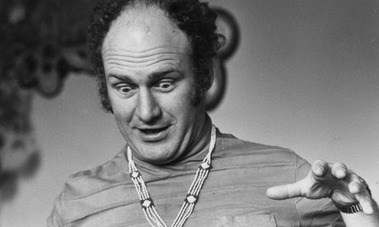
Inspiration from Usage of Drugs
Volunteered in a CIA experiment on the effect of psychoactive drugs
Kesey wrote in detail about his experiences with LSD, cocaine and other psychedelics such as mescaline and DMT
He worked at the Menlo Park Veterans Hospital as a night aide during the ongoing drug experiment

Slide 4
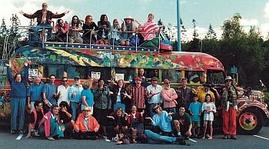
Merry Pranksters
A group of friends including Kesey whom had hobbies such as going on road trips while high on LSD
At one point, in 1965, Kesey was arrested for marijuana possession
In an effort to mislead police, he faked his suicide and then fled to Mexico
After Kesey returned to the United States, he was arrested and jailed for 5 months

Slide 5

One Flew Over the Cuckoo’s Nest
Synopsis
Conflict between Randle McMurphy and Nurse Ratched
Nurse Ratched is seen as the evil oppressive ruler of the ward and Randle McMurphy who reveals to the patients their power through laughter and defiance of Nurse Ratched
Main Themes:
Suppression by Society
Prominence of Sexuality
Insanity
Overpowering of Women
“What do you think you are, for Chrissake, crazy or somethin'? Well you're not! You're not! You're no crazier than the average asshole out walkin' around on the streets and that's it. ”- McMurphy

Slide 6

Sometimes a Great Notion
Synopsis
There are two main conflicts:
Leland Stamper vs Hank Stamper
The Stamper clan vs the town of Wakonda, Oregon
Leland wants revenge against his half-brother, who had sex with his mother, but this turns out to be twisted as it was his mother who seduced Hank
The Stamper clan is threatened by the logging union for continuing business during a strike and is subject to arson and sabotage, causing the deaths of Henry Stamper and Joe Ben
Main Themes:
Individualism
Resistance from the Flows of Society
Independence
“Never Give an Inch”- Stamper family

Slide 7
Trailer
https://www.youtube.com/watch?v=OXrcDonY-B8

